Slide 1
Binary codes
Binary codes are codes which are represented in binary system with modification from the original ones.
Weighted Binary codes
Non Weighted Codes
Weighted binary codes are those which obey the positional weighting principles, each position of the number represents a specific weight.

Slide 2
Reflective Code
A code is said to be reflective when code for 9 is complement for the code for 0, and
so is for 8 and 1 codes, 7 and 2, 6 and 3, 5 and 4. Codes 2421, 5211, and excess-3 are reflective, whereas the 8421 code is not.
Sequential Codes
A code is said to be sequential when two subsequent codes, seen as numbers in binary representation, differ by one. This greatly aids mathematical manipulation of data. The 8421 and Excess-3 codes are sequential, whereas the 2421 and 5211 codes are not.
Non weighted codes
Non weighted codes are codes that are not positionally weighted. That is, each position within the binary number is not assigned a fixed value. Ex: Excess-3 code
Excess-3 Code
Excess-3 is a non weighted code used to express decimal numbers. The code derives its name from the fact that each binary code is the corresponding 8421 code plus 0011(3).
Gray Code
The gray code belongs to a class of codes called minimum change codes, in which only one bit in the code changes when moving from one code to the next. The Gray code is non-weighted code, as the position of bit does not contain any weight. The gray code is a reflective digital code which has the special property that any two subsequent numbers codes differ by only one bit. This is also called a unit- distance code. In digital Gray code has got a special place

Slide 4
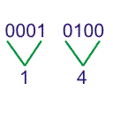
Binary to BCD Conversion
BCD is binary coded decimal number, where each digit of a decimal number is respected by its equivalent binary number.
i.e., LSB of a decimal number is represented by its equivalent binary number and similarly other higher significant bits of decimal number are also represented by their equivalent binary numbers.
Ex: BCD Code of 14 is-

Slide 5
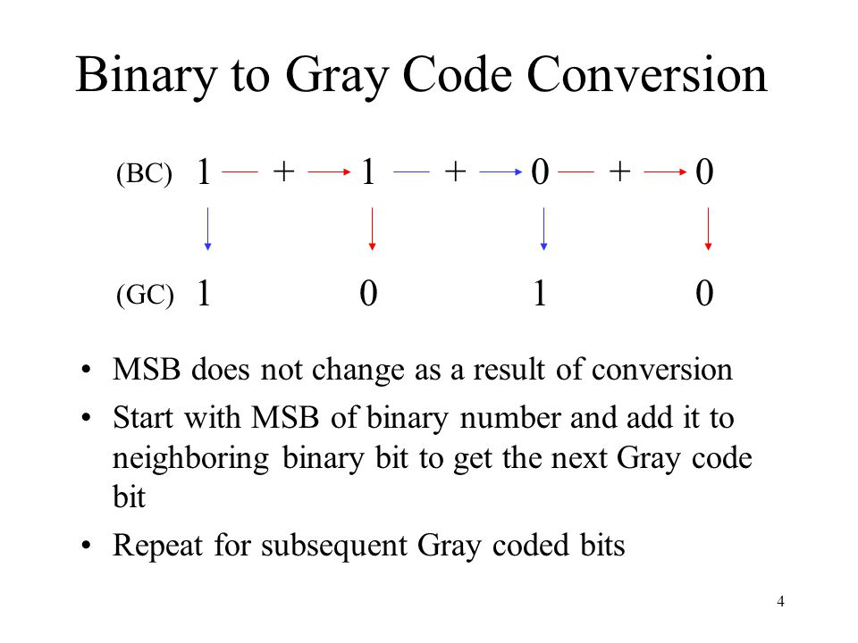
BCD to Gray code Conversion

Slide 6
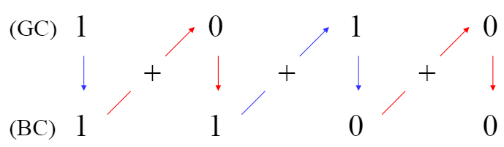
Gray to Binary Code Conversion
MSB does not change as a result of conversion.
Start with MSB of binary number and add it to the second MSB of the Gray code to get the next binary bit
Repeat for subsequent binary coded bits.

Slide 7
BCD to Binary Code Conversion
BCD to binary of 42
4 -> 0100
2 -> 0010
4x10 + 2 = binary
0100x1010 + 0010 = 0101010

Slide 8
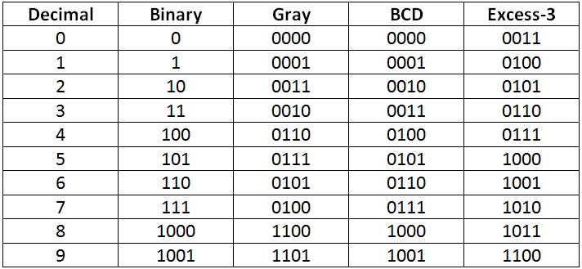
For Excess-3 add 3 to BCD number

Slide 9
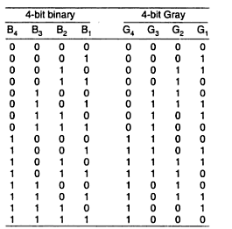
CODE CONVERTERS
A code converter is a logic circuit whose inputs are bit patterns representing numbers (or character) in one code and whose outputs are the corresponding representation in a different code.
Design of a 4-bit binary to gray code converter
Fig :1 Truth table

Slide 10
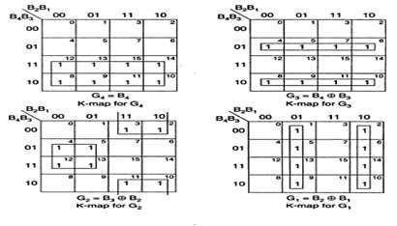

CODE CONVERTERS
K-map simplification

Slide 11
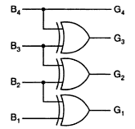
CODE CONVERTERS
Fig: 2 Logic diagram

